Slide 1



Grade 6 - Unit 10

Slide 2


Student’s Book
page 80

Slide 3
Future
Past
We use future to:
We use past to :
1- Talk about a planned action for the future.
I am going to the cinema tomorrow
They are going to London next May.
2- Make prediction.
It is cloudy. I think it is going to rain.
1- Talk about actions happened and
finished in the past.
I visited my friend last week
I ate pizza yesterday.
I bought a new computer in 2017.

Slide 4

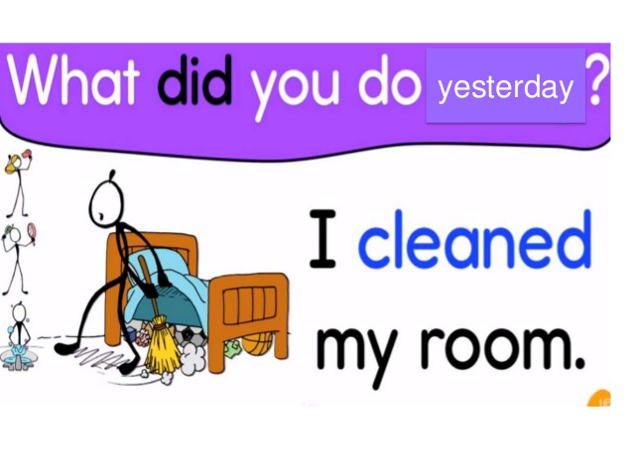



past
future

Slide 5




Slide 6
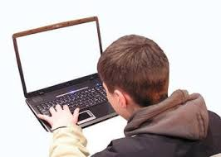
past
I received your
e-mail yesterday.

Slide 7
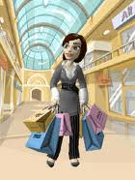

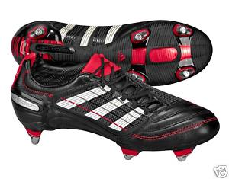

I’m going to buy some football boots tomorrow.
future

Slide 8


Let’s practise more. Read the sentences.
Then say if they are past or future
I bought two presents for my friends last week.
past

Slide 9

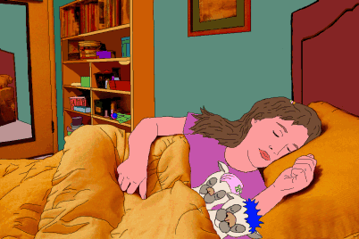
I am going to sleep early tomorrow.
future

Slide 10
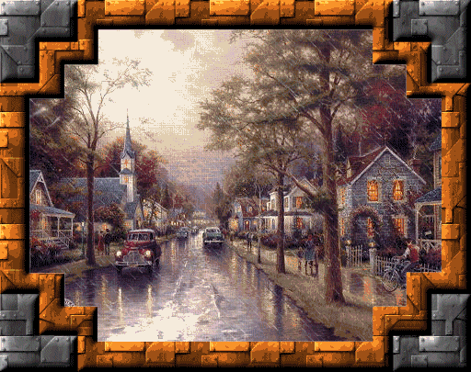
It’s going to rain tomorrow morning.
future

Slide 11




I had a science homework last Wednesday.
past

Slide 13
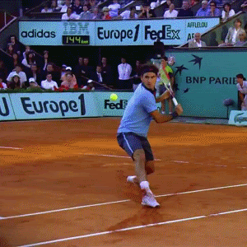

1- I ( am going to buy / bought ) a new tennis racket this weekend.
future

Slide 14
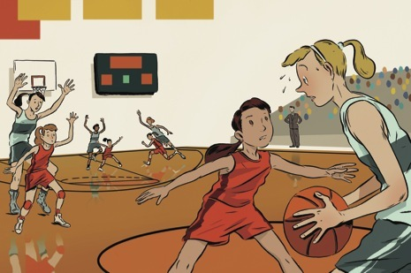
2- She ( played – is going to play ) basketball last week.
past

Slide 15


3- I’m sure my brother ( is going to win – won ) the swimming race tomorrow.
future

Slide 16
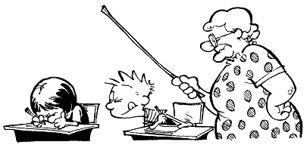

4- We ( are going to have – had ) a science test last week.
past

Slide 17
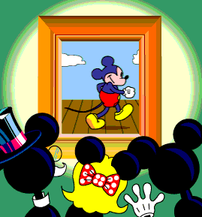
5- My friends and I ( are going to see – saw ) a new film tomorrow.
future

